Slide 1
Modelling Preferences in PDDL 3.0
Yes!

Slide 2
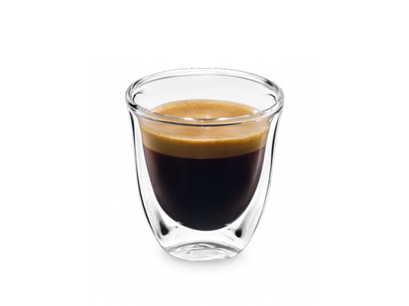



Goals for today
Get to work
If I do that, get a coffee on the way
If I get a coffee, go to the loo after
Play the piano

Slide 3
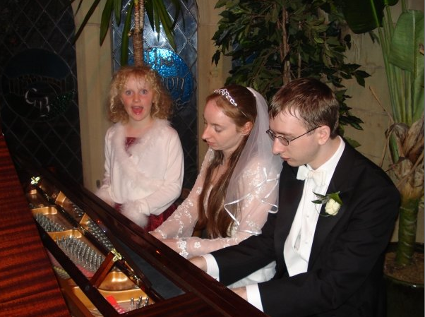
Goals for today
Get to work
If I do that, get a coffee on the way
If I get a coffee, go to the loo after
Play the piano

Slide 4
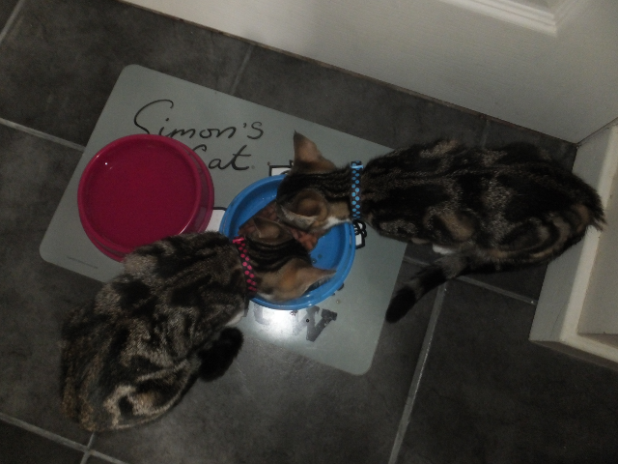
Goals for *the end* of today?
(:goals (and
(at amanda work)
)
)

Slide 5
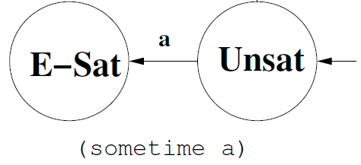
Work/life balance
(sometime (at amanda work))
(sometime (at amanda piano))

Slide 6
Selling out...
(preference p0 (sometime (at amanda work)))
(preference p1 (sometime (at amanda piano)))
cost(p0) = 100
cost(p1) = 5

Slide 7
With goal(s)
(:goal (and
(at amanda mybed)
))
(:constraints (and
(preference p0 (sometime (at amanda work)))
(preference p1 (sometime (at amanda piano)))
))

Slide 8
If I do that, get a coffee on the way
(sometime (at amanda coffeeshop)) ?
(sometime-before (at amanda work)
(at amanda coffeeshop))

Slide 9
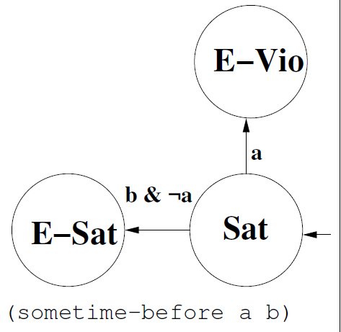
a = (at amanda work) b = (at amanda coffeeshop)

Slide 10
If I get a coffee, go to the loo
(sometime (at amanda loo)) ???

Slide 11
If I get a coffee, go to the loo
(sometime-before (at amanda work)
(at amanda coffeeshop))
(sometime-after (at amanda coffeeshop)
(at amanda loo))

Slide 12
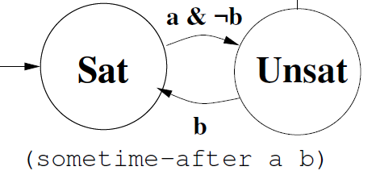
a = (at amanda coffeeshop) b = (at amanda loo)

Slide 13
Sometime-Before vs Sometime-After
(sometime-before (at amanda work)
(at amanda coffeeshop))
(sometime-after (at amanda coffeeshop)
(at amanda work))
These are not inverses:
  If I go to work then I have to have coffee first;
  If I drink coffee I have to go to work afterwards.

Slide 14
Watch Out!
What if playing the piano adds (played amanda piano):
(sometime-after (at amanda work)
(played amanda piano))
Order a then b then c?
(and (sometime-before (b) (a))
(sometime-after (b) (c))
We can satisfy this with b, c, a, b not just a, b, c!

Slide 15
One last sort of preference
(:goal (and
(at amanda mybed)
(preference p4 (switched-off phone))
))

Slide 16
Solving Planning Problems With Soft Goals

Slide 17
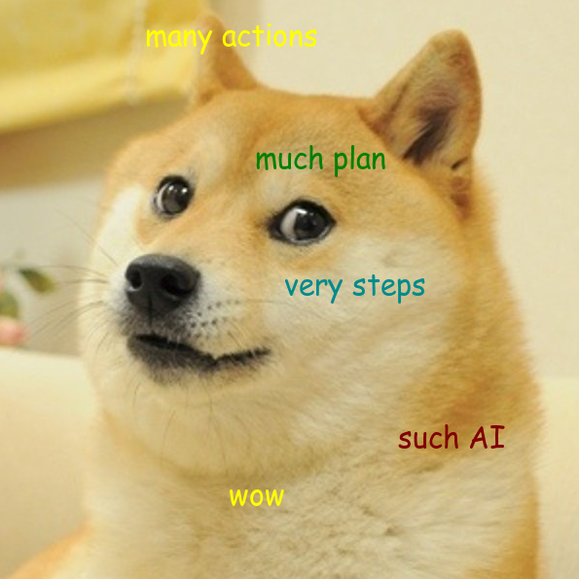

Goal preferences must be easy?
It's almost a goal, c'mon...

Slide 18
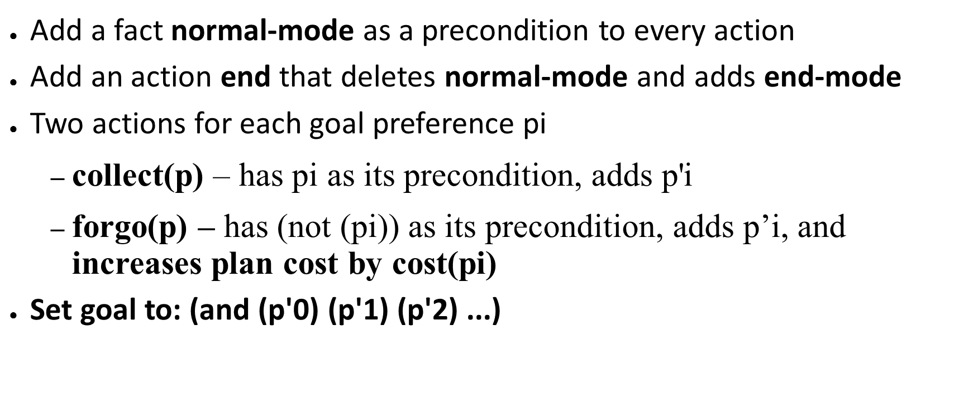
Compiling goal preferences

Slide 19
RPG Heuristic?
What's a relaxed plan for a problem with four compiled-away goal preferences?

Slide 20
RPG Heuristic?
What's a relaxed plan for a problem with four compiled-away goal preferences?
(end)
(forgo p0) (forgo p1) (forgo p2) (forgo p3)
h(S) = 5 ('distance to go')
Regardless of how close it is to meeting a goal

Slide 21
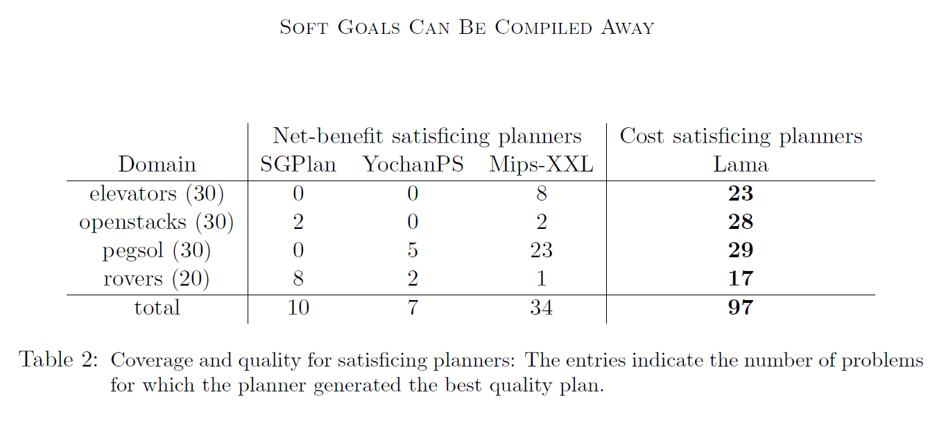
Keyder & Geffner, JAIR, 2009

